Slide 1
RNA Sequencing Workflow to Conduct Differential Expression and Gene Set Enrichment Analysis
Marth Lab
Jason Kunisaki
July 31, 2018

Slide 2
Introduction to RNA-seq
RNA-seq >> Microarray
Detect novel transcripts, isoform structures, and non-coding RNA
Higher sensitivity (true positive rate) and specificity (true negative rate)
Identify rare and low-abundance transcripts
Goal: identify expression profiles that characterize a specific phenotype
tumor vs normal
response vs nonresponse

Slide 3
Illumina RNA-seq (Bulk)
Step 1: Isolate the RNA
Step 2: Break into fragments
Step 3: Convert RNA to double stranded cDNA
Step 4: Add adapter sequences to ends of the fragments
Step 5: PCR amplification of fragments with adapters
Step 6: Quality checks for library size and verify fragment lengths
Step 7: Sequencing

Slide 4
Single Cell RNA Sequencing
Advantages:
Identify transcriptomic changes on a cell-specific basis
Distinguish between cell types
Heterogeneity of cell responses
Caveats:
Lower starting amounts of RNA
Variable gene dropout
Strong batch effects
Cell-to-cell variation may be due to confounding factors (e.g. cell cycle state)
Notes:
Gene ‘dropouts’ in which a gene is observed at a moderate expression level in one cell but is not detected in another cell

Slide 5
Brief Introduction to Bias for RNA Sequencing
Library size
GC content
Feature length
RNA biotype distribution

Slide 6
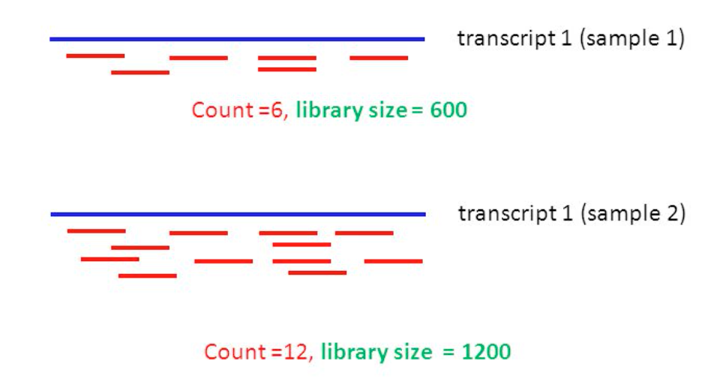
Other Confounding Factors for RNA-seq
Library preparation
Library size
Sample 1 has 6 reads aligning to transcript
Sample 2 has 12 reads aligning to transcript
Appears that transcript 1 is underexpressed in sample 1
Expression is similar since mapped reads comprise 10% of the library
Sample 1
Sample 2

Slide 7
Other Confounding Factors for RNA-seq
GC content
GC poor/rich fragments underpresented
Originates from PCR amplification step in library preparation
Single stranded fragments form hairpin loop
Altering thermocycle length, temperature, and enzymes used can reduce bias

Slide 8
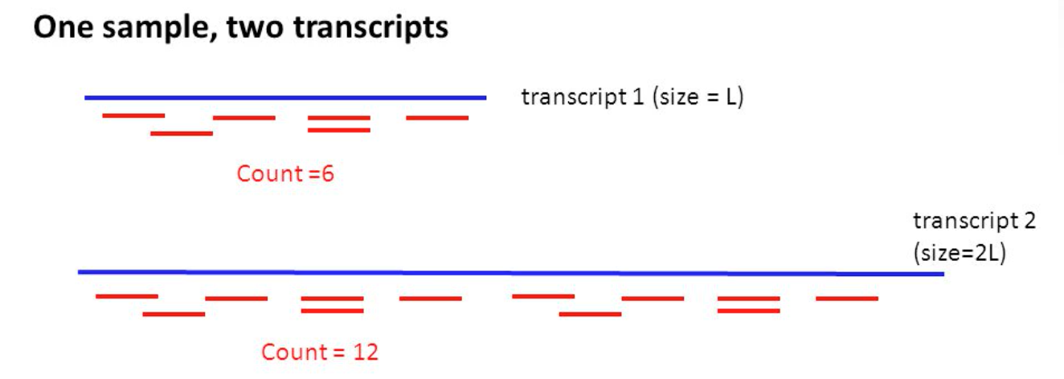
Other Confounding Factors for RNA-seq
Feature length
Short transcript will have less reads mapped
Long transcript will have more reads mapped
Transcripts appear to be differentially expressed when looking at read counts in isolation
Expression is actually similar when considering the length of the transcript
Problem when comparing gene expressions within a single sample

Slide 9
Other Confounding Factors for RNA-seq
RNA Biotype Distrubution
RNA-seq experiments largely identifies protein-coding genes
Presence of other RNA biotypes suggest contamination or differences among samples
Important when combining data from different sources/timepoints

Slide 10
Essential Steps for RNA-seq Analysis
FASTQ quality control
Trimming adapter sequences
Demultiplexing
Align reads to reference genome/transcriptome
Filter reads by mapping quality
Generate expression matrix for features (e.g. transcripts, genes, etc.)
Convert to consistent count metric (FPKM vs TPM vs raw counts)
Normalize expression values for features
GC content bias, feature length, library size, batch effects
Create differential expression matrix
Identify biological relevance of significant biological processes
Run Gene Set Enrichment Analysis (GSEA)

Slide 11
Create DE Matrix for GSEA
HISAT2
= Visualization step
software
output
Mapped Reads
Raw Fastq File 1
Raw Fastq File 2
Samtools (sort, filter, flagstat)
FastQC
Filtered Mapped Reads
Trimmomatic
DE Matrix
FeatureCounts/edgeR
Trimmed Fastq File 1
Trimmed Fastq File 2
DESeq2/edgeR/NOISeq
Counts/TPM
FastQC
GSEA/single sample GSEA
NOISeq Normalization
Check trimmed fastqc report to see if adapter sequence is present
Differentially activated pathways
Normalized Counts
Note: Demultiplexing step is needed for single cell RNA sequencing data after trimming and before alignment to reference
Notes:
These functions are written in a bash script

Slide 12
Preparing Fastq Files for Alignment
FASTQC (file:///Users/jasonkunisaki/Desktop/fastqc_report.html)
GC content
Duplication rate
Overrepresented k-mers
Sequence quality
Presence of adapters
Information on output can be found here: http://www.bioinformatics.babraham.ac.uk/projects/fastqc/Help/3%20Analysis%20Modules/
Trimmomatic
Trim adapter sequences
Can trim poor-quality bases to improve mappability

Slide 13
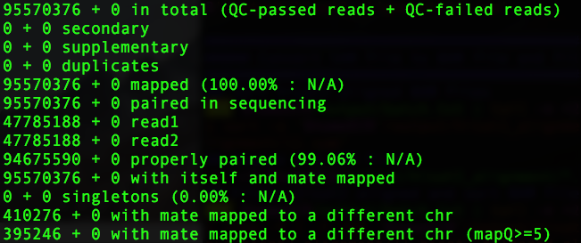
Alignment and Read Filtering
HISAT2
More efficient at mapping than STAR and Tophat2 (esp with large and well annotated reference genomes)
Samtools
Filters: -f 1 –F 268
Keep reads that are paired (-f option)
Remove unmapped reads, unmapped mate, and not primary alignment (-F option)
Refer to https://broadinstitute.github.io/picard/explain-flags.html for samtools flags
Flagstat

Slide 14
Quantifying Expression of Genes
Expression Matrix (raw counts)
genes | sample1 | sample2
653635 | 416 | 270
100422834 | 0 | 0
645520 | 0 | 0
79501 | 0 | 0
729737 | 181 | 224
100507658 | 0 | 1
100132287 | 11 | 17
100288646 | 0 | 0
729759 | 0 | 0
100131754 | 188192 | 192289
FeatureCounts (Rsubread package in R)
Requires reads to be paired
Does not count for chimeric fragments (read pairs that do not align to the same chromosome) and multi-mapped reads
Uses built-in annotation file → outputs entrez id’s for each feature
Output
Raw counts for each feature
Custom script uses feature lengths to convert counts to TPM (normalize the feature lengths)
Stat file
Shows # of mapped and unmapped reads for all features
Stats File
Status | sample1 | sample2
Assigned | 38722489 | 21308314
Unassigned_Unmapped | 0 | 0
Unassigned_MappingQuality | 0 | 0
Unassigned_Chimera | 0 | 0
Unassigned_FragmentLength | 0 | 0
Unassigned_Duplicate | 0 | 0
Unassigned_MultiMapping | 1126610 | 619104
Unassigned_Secondary | 0 | 0
Unassigned_Nonjunction | 0 | 0
Unassigned_NoFeatures | 7135495 | 4896753

Slide 15
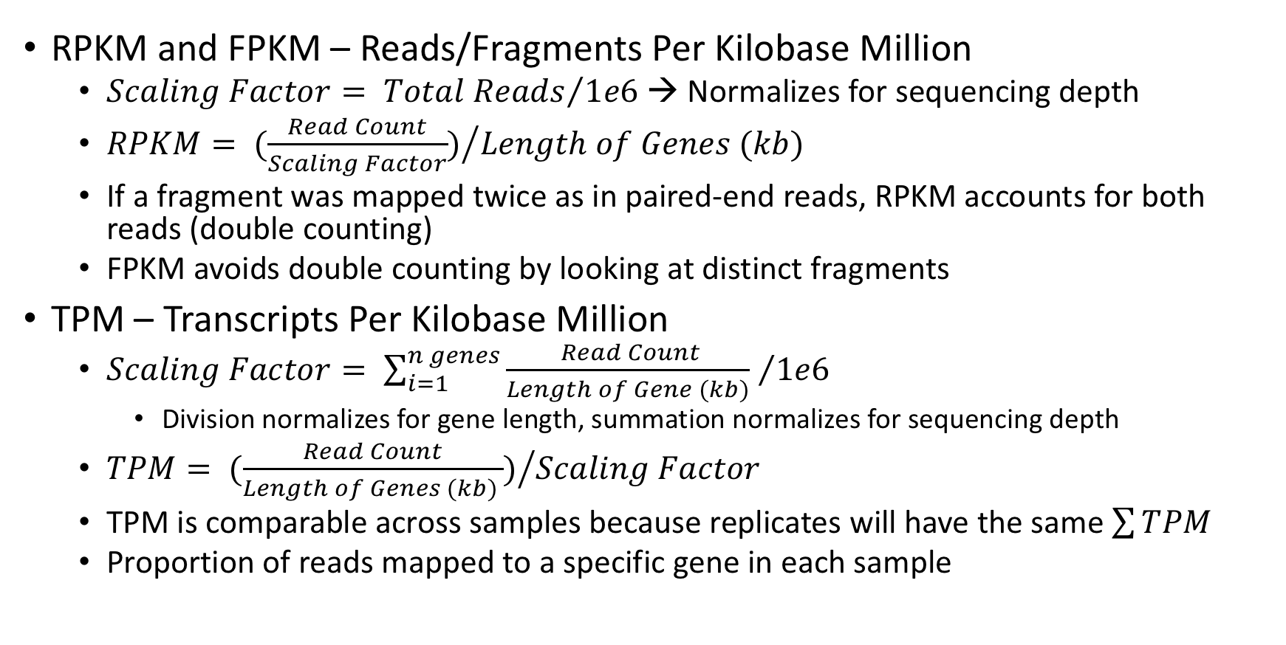
RPKM vs FPKM vs TPM
RPKM and FPKM – Reads/Fragments Per Kilobase Million
$Scaling Factor= {Total Reads}/{1e6}$ → Normalizes for sequencing depth
$RPKM= {(\frac{Read Count}{Scaling Factor})}/{Length of Genes (kb)}$
If a fragment was mapped twice as in paired-end reads, RPKM accounts for both reads (double counting)
FPKM avoids double counting by looking at distinct fragments
TPM – Transcripts Per Kilobase Million
${Scaling Factor= \sum_{i=1}^{n genes}{\frac{ Read Count}{Length of Gene (kb)} }}/{1e6}$
Division normalizes for gene length, summation normalizes for sequencing depth
$TPM= {(\frac{Read Count}{Length of Genes (kb) })}/{Scaling Factor}$
TPM is comparable across samples because replicates will have the same $\sum{TPM }$
Proportion of reads mapped to a specific gene in each sample
Notes:
Normalizes for depth and gene size

Slide 16
NOISeq Normalization
NOISeq functions are used to explore and visualize potential bias
Biotype Detection Plot
Sequencing Depth Plot
Length Bias Plot
GC Content Bias Plot
RNA Composition Plot
Batch Effects
Other software/functions will be implemented to perform the bias correction
DE analysis should not include correction for length and gc content bias while GSEA should (to generate the ranked expression list in each sample)

Slide 17
NOISeq Normalization
Biotype Detection Plot
Are a majority of the detected features protein coding?
Gray bar: % of each biotype in the whole set of provided features
Stripped Bar: % of each biotype in a single sample with # of counts > x
Solid bar: % of each biotype within the sample
Dotted green line separates most abundant biotypes (to the left)
Bars on the left have the left y-axis
Bars on the right have the right y-axis
Can generate plots on per-sample or per condition-basis

Slide 18
NOISeq Normalization
Sequencing Depth Plot
# of features in genome with > k counts at the sample’s sequencing depth (left y-axis)
Simulates feature detection numbers with higher and lower sequencing depths
Vertical bars: # of new features detected when increasing sequencing depth (right y-axis)
Only when there are 2 samples
% detected value: % of features detected with more than k counts at the real sequencing depth (solid point on top graph)

Slide 19
NOISeq Normalization
Low Count Features Plot
Features with low counts are not reliable and produce noise
Bars: % of features that have more than 0, 1, 2, 5, or 10 counts per million (CPM)
Horizontal lines: % of features with a specified CPM value in at least 1 sample
“75 % of the features will have a CPM value greater than 1 in at least one of the two samples. The other 25% will have a CPM value less than 1”
Sequencing depth shown at the top

Slide 20
NOISeq Normalization
Length Bias Plot
Input values were raw counts → bias was expected
Cubic spline regression model used to describe relationship between length and expression
R2 > 70% or p-value < 0.05
Any TPM calculation will correct for this bias

Slide 21
NOISeq Normalization
GC Content Bias Plot
Cubic spline regression model used to describe relationship
R2 > 70% or p-value < 0.05
Correction can be done with salmon or alpine (TODO)

Slide 22
NOISeq Normalization
RNA composition
Technical bias
Small number of genes highly expressed in one sample but not the other → these genes comprise large portion of the library → other genes are undersampled in that sample
Those “other” genes will appear to be downregulated in the sample → problematic for DE
Bias can be corrected for with edgeR/DESeq2 with Trimmed Median of M-Values (TMM) Methdology

Slide 23
NOISeq Normalization
Batch Effects – Principle Component Analysis (PCA)
Certain genes will influence variation of expression more than others
Multiply ”influence” and read count → sum over all genes in a sample → Principle Component value
PC1: axis that spans most variation in the data
PC2: axis that spans the second most variation in the data
Expression profiles of the 2 samples are varied
Can be due to library size, sequencing depth, or lack of normalization for other sources of bias
EdgeR can correct for batch effects

Slide 24
Create Differential Expression Matrix
DEseq2
Negative binomial distribution
Input is unnormalized counts
Normalizes for library size and RNA composition
Does not care about gene length → length of genes is consistent across all samples → bias is low when comparing expression of the same gene
Limma+voom
Linear model
Recommends Trimmed Mean of M-Values (TMM) normalization (done with edgeR package)
Normalize reads by RNA composition
Can normalize for library size

Slide 25
Previous Reviews on DE Matrix Generation
RNA-Seq differential expression analysis: An extended review and a software tool
Compared 9 different DE software
Mapping methods have minimal impact on final DE analysis
“To consider more methods together tends to improve the accuracy and to reduce the error rates”
DESeq2, NOIseq (non-parametric), and limma+voom had highest rates of specificity and sensitivity → TODO: combine output from these datasets
Notes:
http://journals.plos.org/plosone/article?id=10.1371/journal.pone.0190152#sec006

Slide 26
Differential Expression Analysis
DESeq2
Input: expression matrix of raw counts
Only 2 samples used → little power to identify DE genes
Gene | baseMean | log2FoldChange | lfcSE | stat | pvalue | padj | sample1 | sample2
ENSG00000233750 | 307.926395 | 5.90582015 | 2.16088467 | 2.73305662 | 0.00627495 | 0.99702596 | 8 | 5
ENSG00000237973 | 433.94344 | 3.82366875 | 1.62333582 | 2.35543915 | 0.01850083 | 0.99702596 | 555783 | 502158
ENSG00000240618 | 464.596703 | 3.73023186 | 1.5878495 | 2.34923515 | 0.01881202 | 0.99702596 | 7 | 9
ENSG00000187583 | 397.65207 | 3.62844952 | 1.59227997 | 2.27877609 | 0.02268038 | 0.99702596 | 86 | 79
ENSG00000273443 | 419.165483 | 3.56994259 | 1.56741912 | 2.27759286 | 0.02275085 | 0.99702596 | 6 | 5
ENSG00000162572 | 406.016996 | 3.57497934 | 1.57484357 | 2.27005361 | 0.02320433 | 0.99702596 | 97 | 54
ENSG00000160072 | 2783.84277 | 2.27351518 | 1.0095763 | 2.25194982 | 0.02432544 | 0.99702596 | 812 | 551
ENSG00000197530 | 399.451818 | 3.52173275 | 1.56463798 | 2.25082914 | 0.02439636 | 0.99702596 | 777 | 543
ENSG00000008128 | 2711.24899 | 2.27527139 | 1.01149262 | 2.24941967 | 0.02448581 | 0.99702596 | 93 | 65
ENSG00000182873 | 479.269813 | 3.33475196 | 1.48316131 | 2.24840814 | 0.02455018 | 0.99702596 | 55 | 52

Slide 27
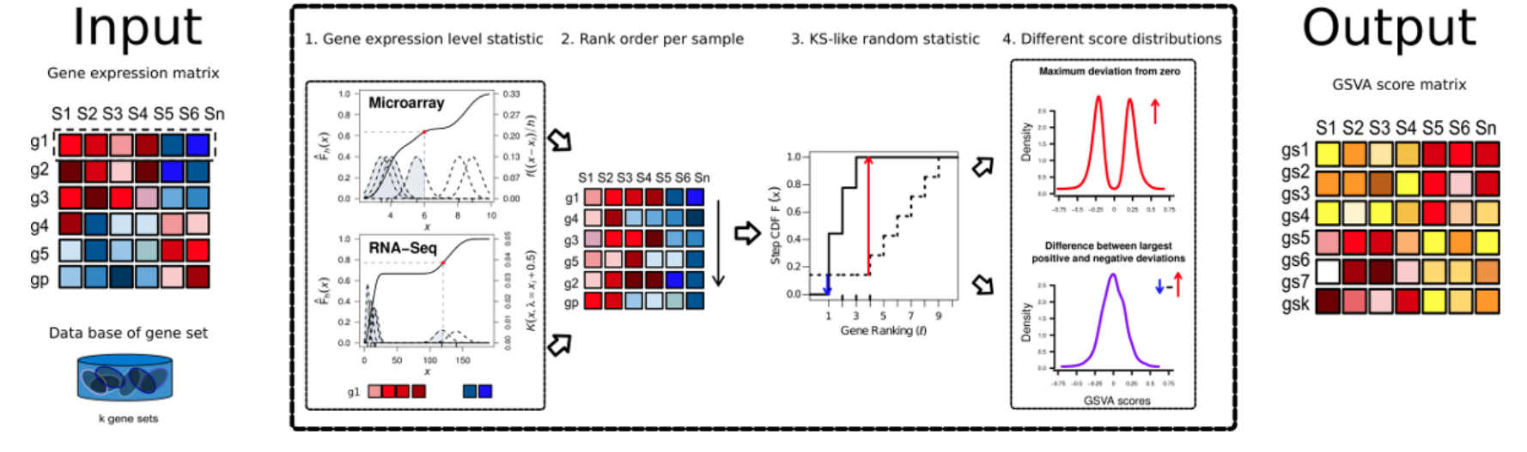
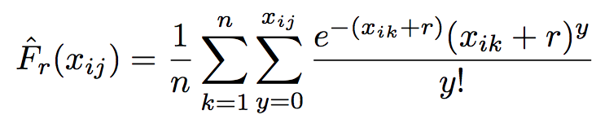
What is Gene Set Enrichment Analysis (GSEA)
Compares expression of gene i in sample j to the sample population distribution
Identify expression changes in predefined set of related genes
Understand affected biological processes and pathways

Slide 28
GSEA – GSVA Package in R
Step 1: Rank genes by expression statistic
Unlike GSEA, GSVA does not require a differential expression matrix
Step 2: Get gene set and compute cumulative sum over ranked genes to get the enrichment score (ES)
Step 3: Permute over different gene order and compute ES score
Step 4: Compare ES score from actual data to distribution of ES scores from permutation data

Slide 29
Which Gene Sets Exist?
H: Hallmark Gene Sets
C1: Positional Gene Sets
C2: Curated Gene Sets
C3: Motif Gene Sets
C4: Computational Gene Sets
C5: GO Gene Sets
C6: Oncogenic Signatures
C7: Immunologic Signatures
https://docs.google.com/document/d/1S-PLsWtOloA1Q8wJCazAcqnnoJc3FvTS1vgcIEXGBbw/edit for more details

Slide 30
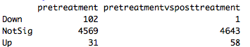
Differentially Activated Pathways
Ovarian cancer single cell dataset
C2 curated gene set
59 pathways differentially activated between pretreatment and posttreatment
Bottom figure: expression signatures of FERRARI_RESPONSE_TO_FENRETINIDE_UP gene list
Pathway upregulated in posttreatment cells

Slide 31
Future Directions with Workflow
Variant calling to identify pathogenic variants that contribute to DE and differentially activated pathways
Accurate GSEA requires a comprehensive understanding on the biological consequence of different transcript isoforms
Intersect gene sets with certain databases such as CIViC/ClinVar/COSMIC/BRCA Exchange (BC) or others that can identify pathogenic factors in different diseases
If GSEA+CIViC say that gene in gene set is dysregulated, then that gene might be clinically actionable or important in the GSEA-specified pathway

